Slide 1
The Oil Crises as Fulcrum for the Rise and Fall of the Third World Project
Dane Kennedy, Professor Emeritus
George Washington University, Washington, D.C.

Slide 2
The Third World as a Postcolonial Project “The Third World was not a place. It was a project.” Vijay Prashad, The Darker Nations: A People’s History of the Third World

Slide 3
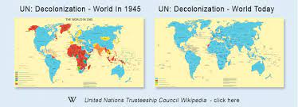
Postwar Decolonization: The Retreat of European Empires and the Global Proliferation of Nation-States
Member states of the United Nations: 51 (1945); 127 (1970); 154 (1980)
Most of new member states were drawn from Africa, Asia, the Caribbean, Latin America, the Middle East, and the South Pacific—i.e., the Third World.

Slide 4
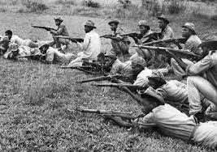
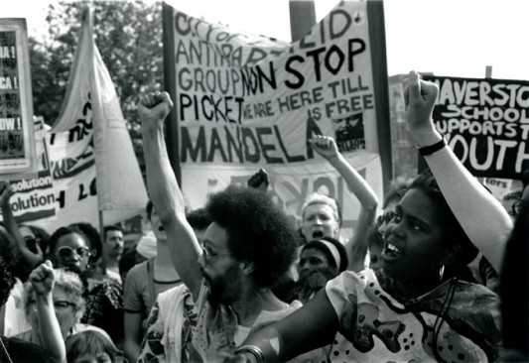
Colonialism’s Last Gasp: Decolonization and the Challenge to Settler Colonialism in the 1970s
Britain, France, the Netherlands, and Belgium had relinquished most or all of their colonial possessions by the early 1970s. The only notable exception was Portugal, which saw its colonial empire collapse in 1974.
Settler colonialism in Rhodesia, South Africa, and Israel became major targets of international condemnation in the 1970s.

Slide 5
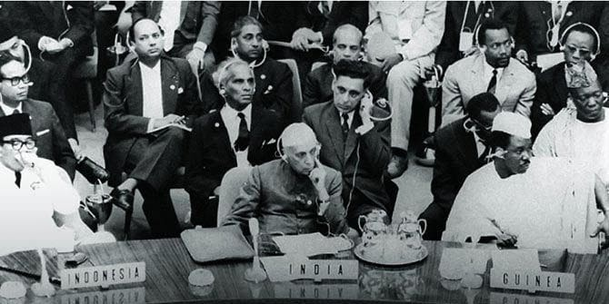
The Rise of the Third World Project: Institution-Building
Bandung Conference (1955): hosted by Indonesia’s Sukarno, it attracted 29 African and Asian states.
Non-Aligned Movement (1956): founded by Josip Tito (Yugoslavia), Jawaharlal Nehru (India), Kwame Nkrumah (Ghana), Sukarno (Indonesia), and Gama Abdul Nasser (Egypt)
OPEC (1960): original member states were Iran, Iraq, Kuwait, Saudi Arabia, and Venezuela
OAU (1963)
OAPEC (1968)

Slide 6
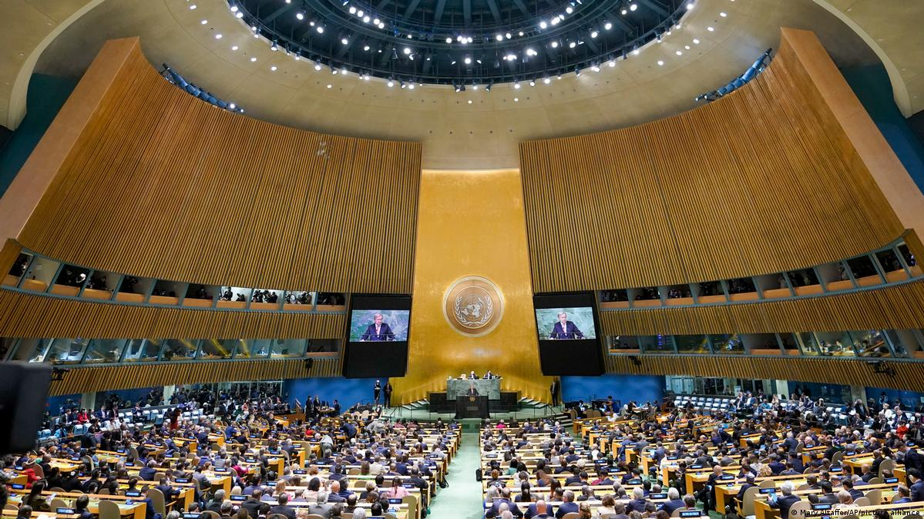
UN General Assembly: Forum for Third World Issues
Resolution 1514 (1960): Declaration on the Granting of Independence to Colonial Countries and Peoples
Resolution 1803 (1963): Declaration of Permanent Sovereignty over Natural Resources
UN Conference for Trade and Development (1964)—UNCTAD
Group of 77 (1964)—G77

Slide 7
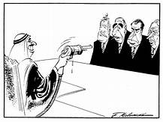
First Oil Crisis (1973-74): Culmination of Third World Solidarity?
Yom Kippur War (October 1973) precipitated oil embargo on US and allies by OAPEC, oil price hike by OPEC.

Slide 8
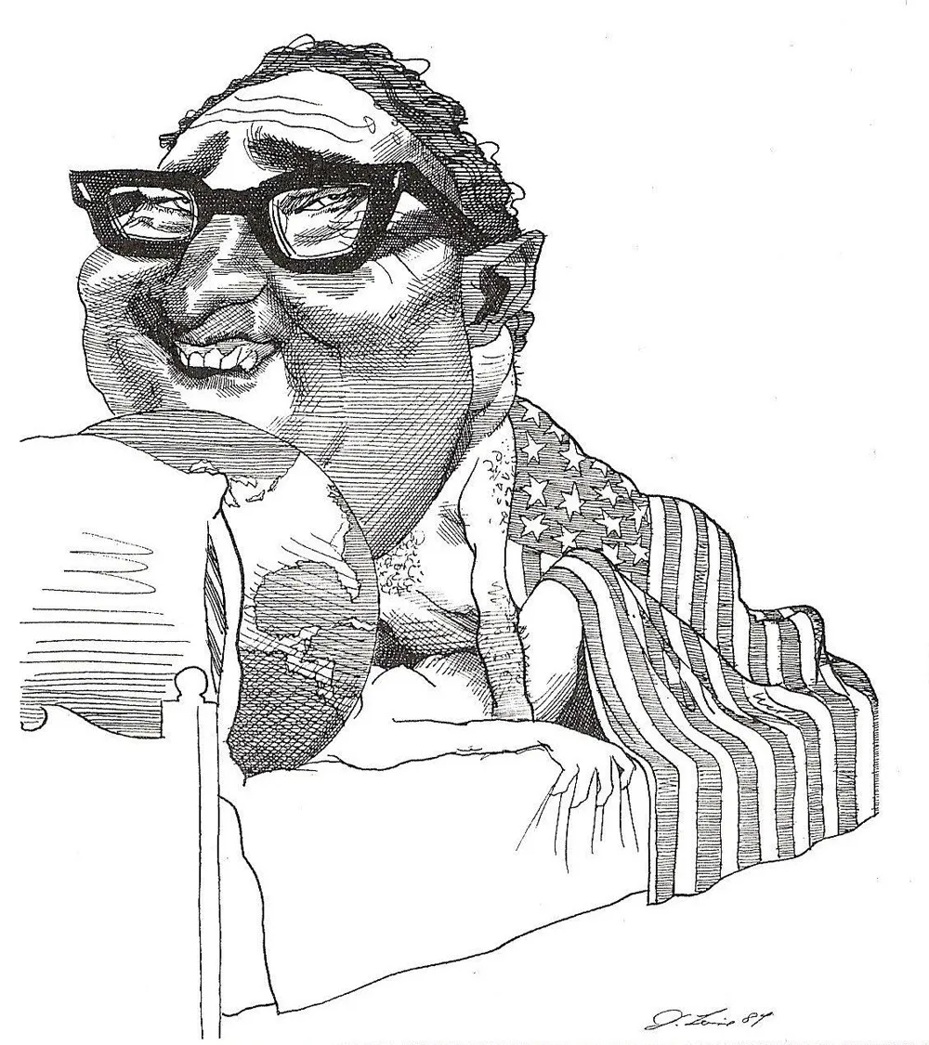
Frustration in the First World: colonial conquest is no longer an option
“I know what would have happened in the nineteenth century. But we can’t do it. The idea that a Bedouin kingdom would hold up Western Europe and the United States would have been absolutely inconceivable. They would have landed, they would have divided up the oil fields, and they would have solved the problem…. That would have been done. And I am note even sure that this is so insane. But that obviously we cannot do.”
Henry Kissinger, October 19, 1973.

Slide 9
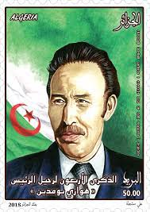
Houari Boumediene and “Boumedienomics”
President of Algeria (1965-1978)
President of Non-Alignment Movement (1973)
Secretary-General of OPEC (1973)
Keynote speaker at UN General Assembly session (1974)
US State Department characterized him as a “major figure of the Third World.”

Slide 10
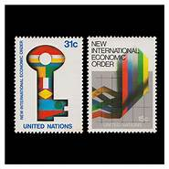
“Declaration for the Establishment of a New International Economic Order”--drafted by UNCTAD, passed by UN General Assembly (May 1974)
The “greatest and most significant achievement during the last decades has been the independence from colonial and alien domination by a large number of peoples and nations.” Yet “existing international economic order” remains unequal; need for new international economic order.
Insists on “sovereign rights of countries to control their own economic affairs,” including “full permanent sovereignty of every State over its natural resources.”
Calls for “restitution and full compensation for the exploitation and depletion of… natural resources.”
Envisions “New International Economic Order based on equity, sovereign equality, interdependence, common interest, and cooperation among all States.”

Slide 11
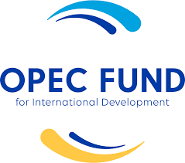
The Third World Project peaks in the mid-1970s: NIEO, OPEC fund for development, etc.

Slide 12
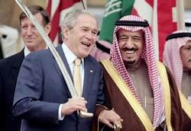
The Third World Frays
Growing gulf between economic interests of OAPEC and OPEC and interests of non-oil producing developing countries.
Setbacks to economies of non-oil producing developing countries due to increased costs of oil imports, aggravating political instability in array of Africa, Asian, and Latin American countries.
This led to ”growing tensions among developing states” and “fear [that] temptation may exist to sacrifice group objectives to narrow [national] interests,” according to a CIA analysis in April 1976.
New alignment of economic and strategic interests as oil-producing countries invested petrodollars in Western capital markets.

Slide 13
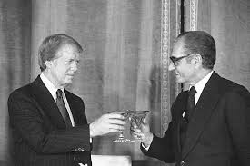
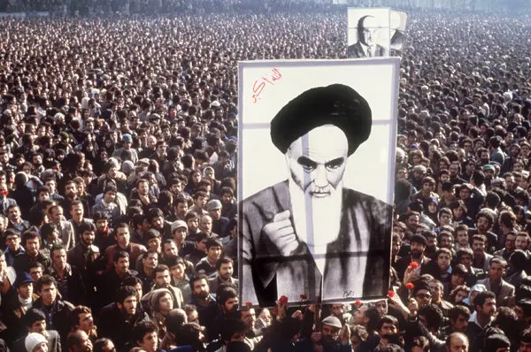
Second Oil Crisis (1979)
Precipitated by the Iranian Revolution, which was driven by domestic political problems, not the struggle against the Western economic order.
Shah of Iran, who had been installed in American-engineered coup and was seen as puppet of US, was overthrown by supporters of Ayatollah Khomeini.
The interruption in Iranian oil production precipitated a spike in global oil prices.

Slide 14
Second Oil Crisis as Death Knell for Third World
Crisis accentuated global economic upheaval of earlier oil crisis, led to neoliberal monetarist policies of Reagan and Thatcher.
Rejection of redistributionist economic proposals made at Cancun conference (1981) effectively ended NIEO hopes.
Many non-oil producing developing countries, especially in Africa and Latin America, entered era of economic decline, made worse by neoliberalism’s ‘structural adjustment’ policies.
Policies pursued by many Asian countries brought them increasing economic growth, a marked shift from other Third World countries. This has been the main focus of the project led by Professor Shigeru.

Slide 15
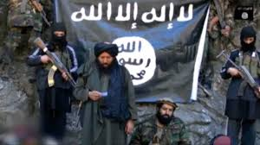
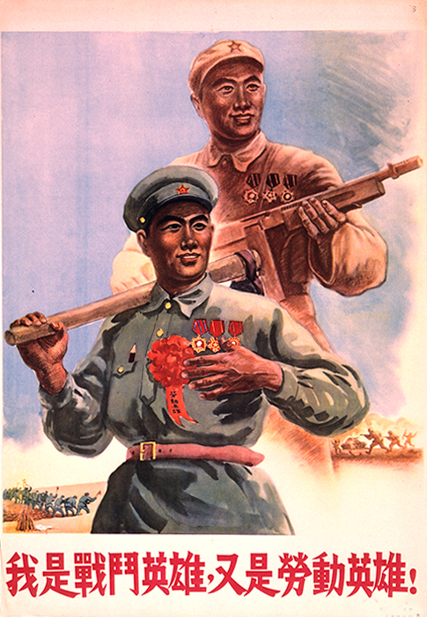
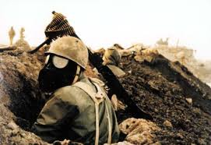
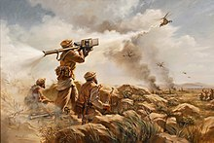
Political and Ideological Fragmentation of the Third World
Evidence of the fragmentation of the Third World after 1979 included the rise of Islamist movements across the Middle East and North Africa, the Iran-Iraq war, the Soviet-Afghan war, and the Sino-Vietnam War.

Slide 16
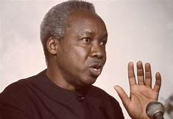
Julius Nyerere
“The Group of 77 does not have an ideology in common. Some of us are for a socialism that claims to be ‘scientific,’ others simply socialists, others capitalists, others theocracies, and still others fascists! And we are not necessarily all friendly with one another: Several countries are today at war with each other. Our per capita income varies from $100 to $2,000 dollars per year. Some of us have minerals, others do not; some of us have no access to the sea, while others are surrounded by enormous oceans. The immediate interests and negotiating priorities of the G77 countries are thus quite different. There is OPEC, the poorest countries, the Least Developed, the Newly Industrialized, the landlocked, and so on.”

Slide 17
Conclusions
Oil crises of the 1970s were integral to the Third World project. These crises were in part a legacy of European colonialism and decolonization’s failure to resolve the ongoing inequalities in the international economic order.
The 1973-74 oil crisis was a manifestation of Third World countries’ determination to assert their sovereign rights of the natural resources within their borders. It inspired efforts to pursue a New International Economic Order.
The first oil crisis also exposed the different interests and ideologies of developing countries. The second oil crisis in 1979 accentuated these differences and undermined the Third World project.

